Slide 1


Well-Spring Specialist Hospital
Healthcare Data Analysis
By Kingsley Emediong Blessing
October 2025

Slide 2

INTRODUCTION
Hospitals generate large amounts of data from admissions, diagnoses, treatments, and billing.
Much of this data remains unused, leading to inefficiencies in care, resource use, and finances.
This project analyzes patient data from Well-Spring Specialist Hospital.
The project's ultimate goal is to transform this raw hospital information into meaningful, actionable insights to support evidence-based management and significantly improve overall healthcare service delivery.

Slide 3
Problem Statement
Well-Spring Specialist Hospital generates large volumes of data but struggles to convert it into actionable insights.
This limits understanding of patient health trends, operational efficiency, and financial management.
This project aims to analyze hospital data to improve patient care, optimize operations, and support evidence-based decisions.
Who is my client?
Well-Spring Specialist Hospital Management Team

Slide 4
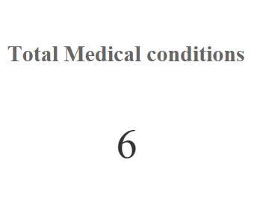
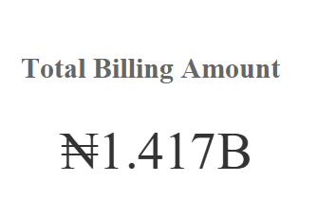
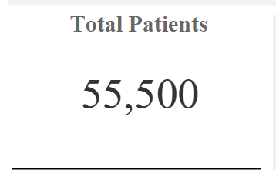
KEY METRICS

Slide 5
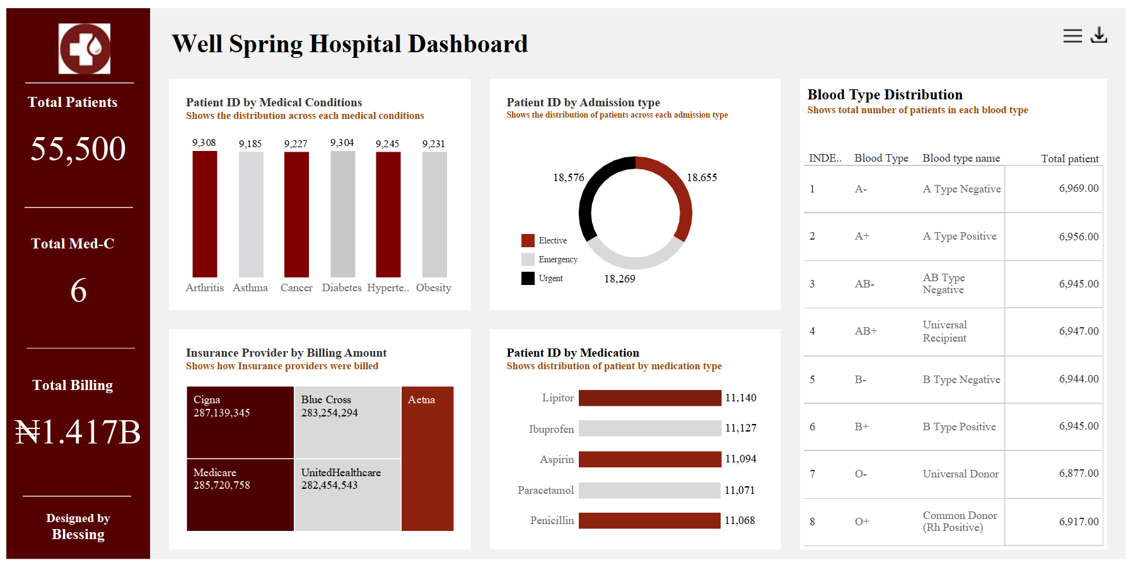

Slide 6
OBJECTIVES
To examine Patient Demographics and Health Patterns
To assess Clinical and Operational Performance
To analyze Financial and Insurance Factors
To provide evidence-based recommendations that improve patient care, optimize hospital operations, and manage healthcare costs effectively.

Slide 7

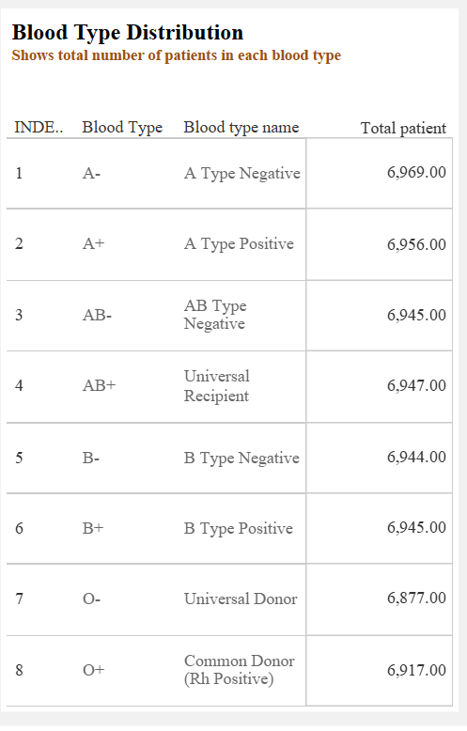
Task 2: To examine Patient Demographics and health patterns
Facts
Shows the total number of patients in each blood type
Findings
6,944 patients have B type negative blood type
6,945 patients have B type positive blood type
6,969 patients have A type negative blood type
6,956 patients have A type positive blood type
6,945 patients have AB type negative blood type
6,947 patients have AB type positive blood type
6,877 patients have O type negative blood type
6,917 patients have O type positive blood type
Insights
The counts for each blood type are fairly balanced.
The A and O blood types have slightly higher population compared to the B and AB blood type
For each blood type, the Rh-positive variant slightly exceeds the Rh-negative count.

Slide 8

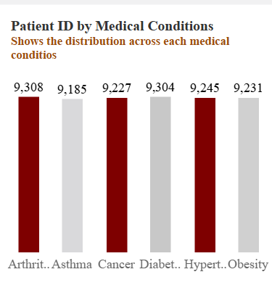
Health patterns
Facts
The number of patients for each of the six listed medical conditions is extremely close, ranging from a low of 9,185 to a high of 9,308.
Findings
The chart shows:
9,308 patients have Arthritis
9,185 patients have Asthma
9,227 patients have cancer
9,304 patients have Diabetes
9,245 patients have Hypertension
9,231 patients have Obesity
Insights
Chronic diseases such as Arthritis, Diabetes, Hypertension, and Obesity have the highest patient counts, all exceeding 9,200 cases which shows a population burdened by long-term lifestyle or age-related conditions, requiring continuous management.
The strong presence of Diabetes, Obesity, and Hypertension suggests a growing trend of lifestyle-related health issues, possibly influenced by diet, inactivity, or stress.

Slide 9
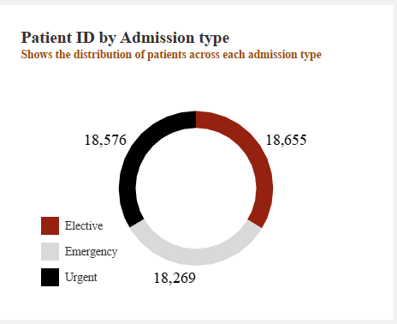
Task 2: Clinical Performance
Facts
The chart shows a nearly equal distribution across all three types, with the highest count (Elective: 18,655) and the lowest count (Emergency: 18,269) differing by only 386 patients.
Findings
18,655 patients were admitted under Elective cases.
18,576 patients were admitted under Urgent cases.
18,269 patients were admitted under Emergency cases.
Insights
Elective admission type records 18,655 patients which may indicate strong hospital capacity for scheduled treatments and surgeries, reflecting organized service delivery.
The balance across the three categories suggests the hospital manages a wide range of patient needs from planned procedures to unplanned and urgent cases.

Slide 10
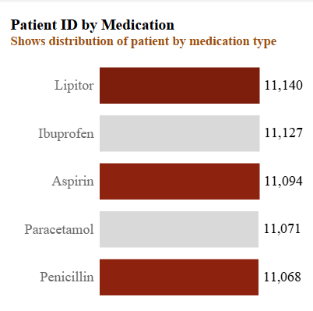
Operational Performance
Facts
The medication with the highest number of patients in the chart is Lipitor, with a total of 11,140 patients.
The medication with the lowest number of patients is Penicillin, with a total of 11,068 patients.
Findings
11,140 patients were prescribed Lipitor
11,127 patients were prescribed Ibuprofen
11,094 patients were prescribed Aspirin
11,071 patients were prescribed Paracetamol
11,068 patients were prescribed Penicllin
Insights
The high Prescription of Lipitor suggests a high prevalence of cholesterol-related or cardiovascular conditions, which aligns with the hospital’s strong focus on managing chronic lifestyle diseases.
With Ibuprofen, Aspirin, and Paracetamol having a high patient count of over 11,00 each suggest a wide use of common pain relievers
Penicillin shows the least prescription with 11,068 patients count compared to the remaining medications which could suggest that the drug is either new or patients have developed antibiotic resistance to it.

Slide 11
Medication Prescription Patterns
11,140
11,127
11,068
Lipitor
Ibuprofen
Penicillin
Highest prescription rate indicates strong focus on cardiovascular/cholesterol management
Common pain reliever widely used across patient population
Lowest prescription rate suggests possible antibiotic resistance concerns

Slide 12
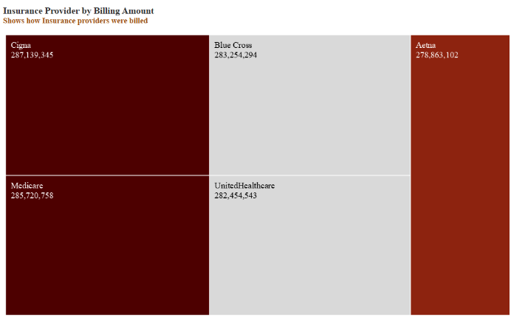
Financial & Insurance Analysis
Facts
Cigna was billed ₦287,139,345, the highest among all insurance providers.
Aetna was billed ₦278,863,102, the lowest billing total.
Other insurance providers were billed as follows:
Medicare: ₦285,720,758
Blue Cross: ₦283,254,294
UnitedHealthcare: ₦282,454,543
Findings
All five insurance providers were billed within a close range (₦278M–₦287M), showing fairly balanced financial distribution.
Cigna and Medicare dominate the billing share, together accounting for a significant portion of total billed amounts.
Aetna shows the lowest billing volume, showing fewer or lower-value claims compared to others.
Balanced billing across providers (₦278M–₦287M) shows diversified revenue. Cigna and Medicare lead; Aetna warrants investigation for growth opportunities.

Slide 13
Financial & Insurance Analysis
Insights
The close billing amounts suggest that the hospital serves a wide range of insurance providers, avoiding dependency on a single company.
Since Cigna has the highest billing total, it may represent a large insured patient base or higher-cost treatments, making it a key financial partner.
Aetna’s lower billing volume could warrant investigation possibly fewer enrolled patients, limited coverage, or lower-cost procedures.
Balanced billing across providers (₦278M–₦287M) shows diversified revenue. Cigna and Medicare lead; Aetna warrants investigation for growth opportunities.

Slide 14

Key Recommendations
Patient Care
Operations
Establish chronic disease clinics, implement preventive screening programs, and develop personalized lifestyle modification plans for high-prevalence conditions.
Balance admission workload with data-driven scheduling, deploy real-time dashboards, and train staff on data literacy for informed decisions.
Financial
Strengthen partnerships with Cigna and Medicare, investigate Aetna's lower billing, and implement cost tracking for high-spending areas.

